Slide 1
TEAM INVESTORS APP SAVE MONEY
Họ và tên: Nguyễn Hải Dương Lớp: 20SE4 MSV: 20IT311
Tạ Ngô Quốc Quân Lớp: 20DA MSV: 20IT015

Slide 2
TABLE OF CONTENT
01
02
03
04
Reasons for choosing the topic
App development language
System analysis and design
05
The functions of the app
What the app has and hasn't done

Slide 3
Reasons for choosing the topic
Money note was born with the purpose of helping people to manage their income and expenses and the fastest way to reach the first level of financial freedom, called “Clearness”.

Slide 4
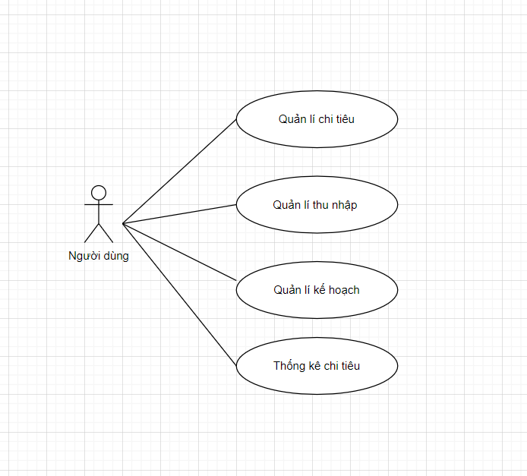
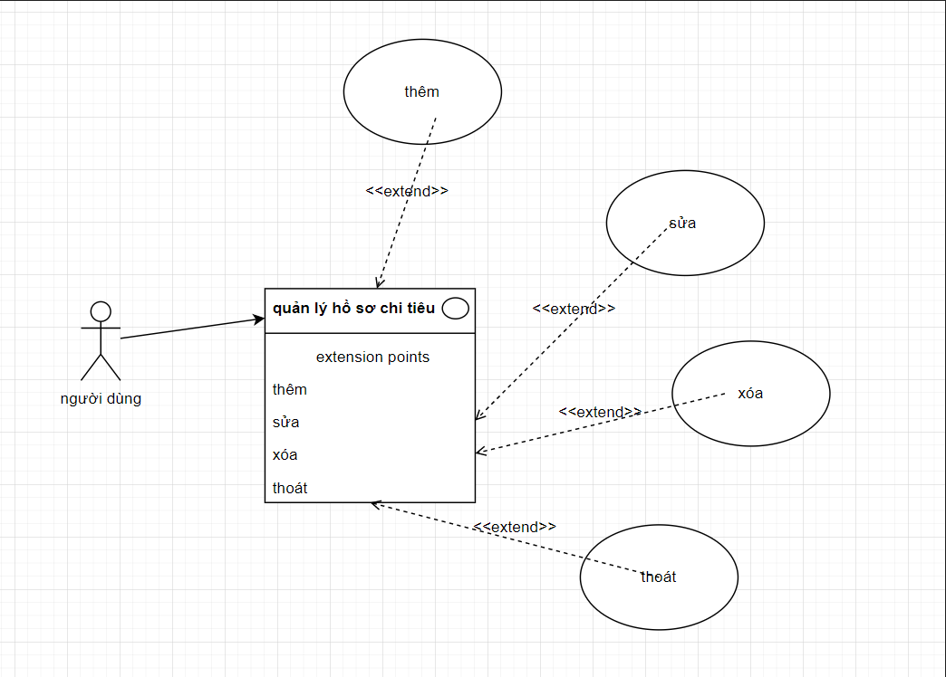
System analysis and design

Slide 5

App development language
Java is a class-based, object-oriented, programming language designed to have as few implementations as possible. It is a general purposeallowing application developers write once, run anywhere , that is, Java code compiled can run on all platforms that support Java without compiling re-translated.

Slide 6
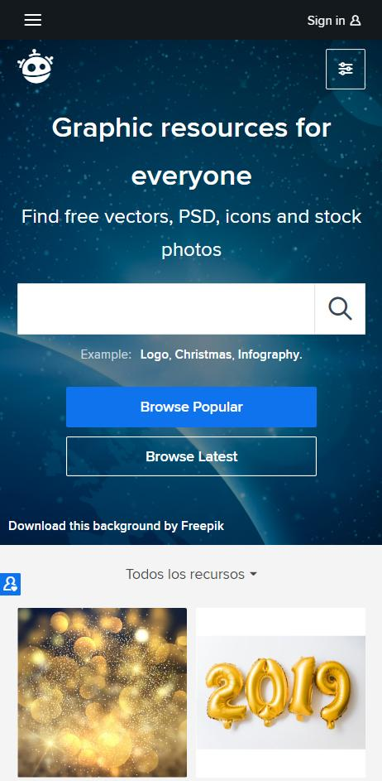
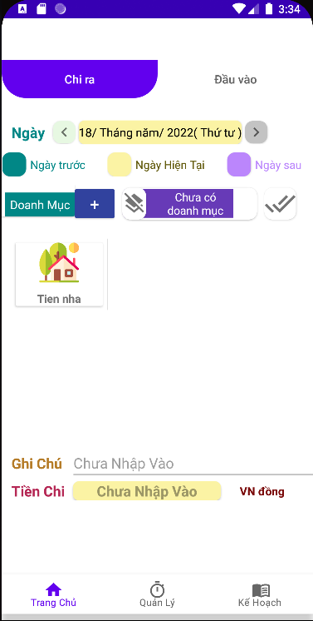
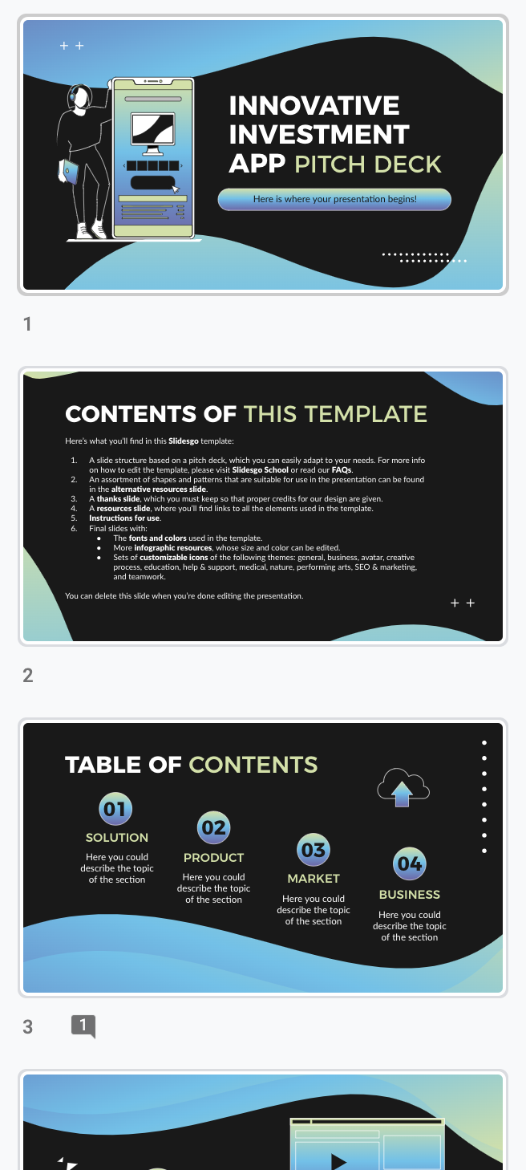
The functions of the app
Add, edit, delete spending list
Statistics of spending or income by month
Assess income and expenses
NEPTUNE
Neptune is the eighth planet.

Slide 7
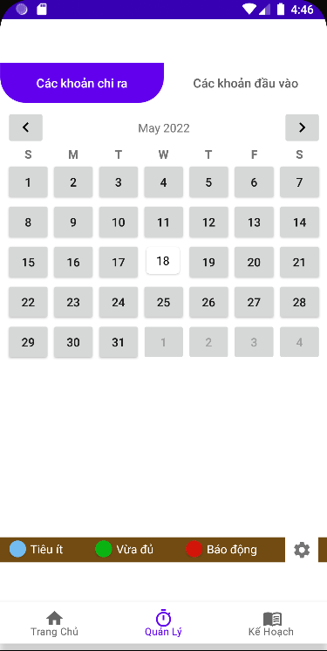

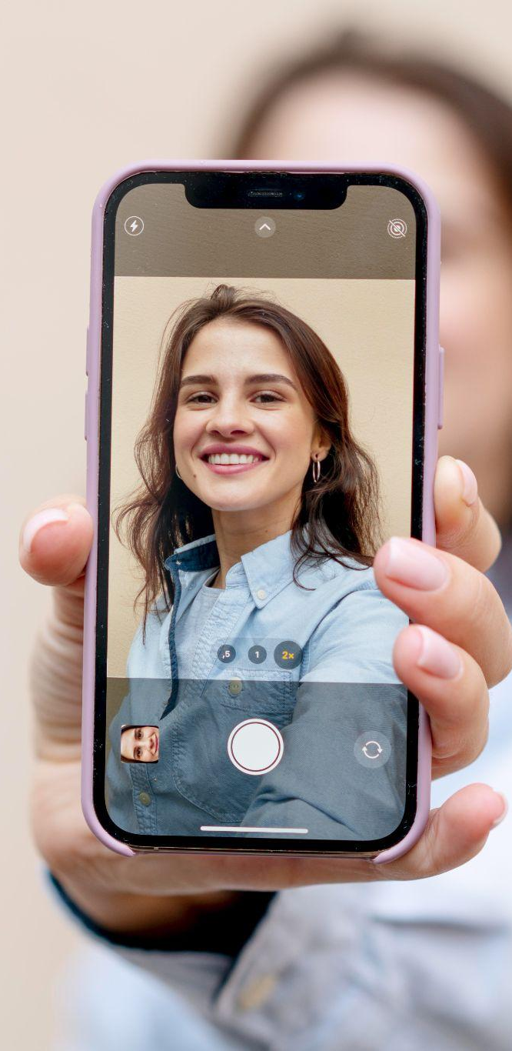
What the app has and hasn’t done
Did it
Haven't done it yet
Functions add edit delete
Spending statistics for the month
Evaluate the level of spending for the day
Design is lacking in aesthetics
App works sometimes lag
Some features are not available yet

Slide 8
Assignment
Dương:
Database
Trang chủ
Quản lý
Quân:
Database
Intro
Kế hoạch

Slide 9
THANKS FOR WATCHING!

